Slide 1
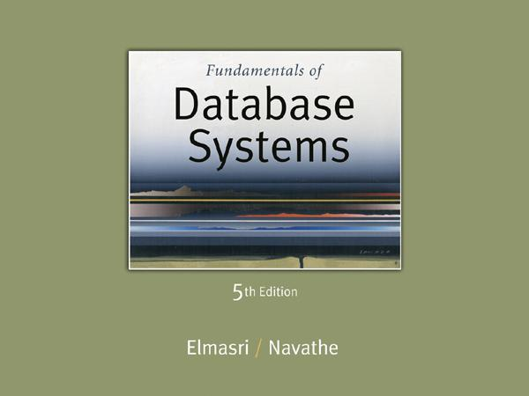
Slide 11- ‹#›
Notes:
‹#›

Slide 2
Chapter 11
Relational Database Design Algorithms and Further Dependencies
Copyright © 2007 Ramez Elmasri and Shamkant B. Navathe
Notes:
‹#›

Slide 3
Chapter Outline
0. Designing a Set of Relations
1. Properties of Relational Decompositions
2. Algorithms for Relational Database Schema
3. Multivalued Dependencies and Fourth Normal Form
4. Join Dependencies and Fifth Normal Form
5. Inclusion Dependencies
6. Other Dependencies and Normal Forms
Slide 11- ‹#›
Notes:
‹#›

Slide 4
DESIGNING A SET OF RELATIONS (1)
The Approach of Relational Synthesis (Bottom-up Design):
Assumes that all possible functional dependencies are known.
First constructs a minimal set of FDs
Then applies algorithms that construct a target set of 3NF or BCNF relations.
Additional criteria may be needed to ensure the the set of relations in a relational database are satisfactory (see Algorithms 11.2 and 11.4).
Slide 11- ‹#›
Notes:
‹#›

Slide 5
DESIGNING A SET OF RELATIONS (2)
Goals:
Lossless join property (a must)
Algorithm 11.1 tests for general losslessness.
Dependency preservation property
Algorithm 11.3 decomposes a relation into BCNF components by sacrificing the dependency preservation.
Additional normal forms
4NF (based on multi-valued dependencies)
5NF (based on join dependencies)
Slide 11- ‹#›
Notes:
‹#›

Slide 6
1. Properties of Relational Decompositions (1)
Relation Decomposition and Insufficiency of Normal Forms:
Universal Relation Schema:
A relation schema R = {A1, A2, …, An} that includes all the attributes of the database.
Universal relation assumption:
Every attribute name is unique.
Slide 11- ‹#›
Notes:
‹#›

Slide 7
Properties of Relational Decompositions (2)
Relation Decomposition and Insufficiency of Normal Forms (cont.):
Decomposition:
The process of decomposing the universal relation schema R into a set of relation schemas D = {R1,R2, …, Rm} that will become the relational database schema by using the functional dependencies.
Attribute preservation condition:
Each attribute in R will appear in at least one relation schema Ri in the decomposition so that no attributes are “lost”.
Slide 11- ‹#›
Notes:
‹#›

Slide 8
Properties of Relational Decompositions (2)
Another goal of decomposition is to have each individual relation Ri in the decomposition D be in BCNF or 3NF.
Additional properties of decomposition are needed to prevent from generating spurious tuples
Slide 11- ‹#›
Notes:
‹#›

Slide 9
Properties of Relational Decompositions (3)
Dependency Preservation Property of a Decomposition:
Definition: Given a set of dependencies F on R, the projection of F on R_{i}, denoted by p_{Ri}(F) where R_{i} is a subset of R, is the set of dependencies X → Y in F⁺ such that the attributes in X υ Y are all contained in R_{i}.
Hence, the projection of F on each relation schema R_{i} in the decomposition D is the set of functional dependencies in F⁺, the closure of F, such that all their left- and right-hand-side attributes are in R_{i}.
Slide 11- ‹#›
Notes:
‹#›

Slide 10
Properties of Relational Decompositions (4)
Dependency Preservation Property of a Decomposition (cont.):
Dependency Preservation Property:
A decomposition D = {R1, R2, ..., Rm} of R is dependency-preserving with respect to F if the union of the projections of F on each Ri in D is equivalent to F; that is ((π_{R1}(F)) υ . . . υ (π_{Rm}(F)))⁺ = F⁺
(See examples in Fig 10.12a and Fig 10.11)
Claim 1:
It is always possible to find a dependency-preserving decomposition D with respect to F such that each relation Ri in D is in 3nf.
Slide 11- ‹#›
Notes:
‹#›

Slide 11
Properties of Relational Decompositions (5)
Lossless (Non-additive) Join Property of a Decomposition:
Definition: Lossless join property: a decomposition D = {R1, R2, ..., Rm} of R has the lossless (nonadditive) join property with respect to the set of dependencies F on R if, for every relation state r of R that satisfies F, the following holds, where * is the natural join of all the relations in D:
* (π _{R1}(r), ..., π_{Rm}(r)) = r
Note: The word loss in lossless refers to loss of information, not to loss of tuples. In fact, for “loss of information” a better term is “addition of spurious information”
Slide 11- ‹#›
Notes:
‹#›

Slide 12
Properties of Relational Decompositions (6)
Lossless (Non-additive) Join Property of a Decomposition (cont.):
Algorithm 11.1: Testing for Lossless Join Property
Input: A universal relation R, a decomposition D = {R1, R2, ..., Rm} of R, and a set F of functional dependencies.
1. Create an initial matrix S with one row i for each relation Ri in D, and one column j for each attribute Aj in R.
2. Set S(i,j):=bij for all matrix entries. (* each bij is a distinct symbol associated with indices (i,j) *).
3. For each row i representing relation schema Ri
{for each column j representing attribute Aj
{if (relation Ri includes attribute Aj) then set S(i,j):= aj;};};
(* each aj is a distinct symbol associated with index (j) *)
CONTINUED on NEXT SLIDE
Slide 11- ‹#›
Notes:
‹#›

Slide 13
Properties of Relational Decompositions (7)
Lossless (Non-additive) Join Property of a Decomposition (cont.):
Algorithm 11.1: Testing for Lossless Join Property
4. Repeat the following loop until a complete loop execution results in no changes to S
{for each functional dependency X →Y in F
{for all rows in S which have the same symbols in the columns corresponding to attributes in X
{make the symbols in each column that correspond to an attribute in Y be the same in all these rows as follows:
If any of the rows has an “a” symbol for the column, set the other rows to that same “a” symbol in the column.
If no “a” symbol exists for the attribute in any of the rows, choose one of the “b” symbols that appear in one of the rows for the attribute and set the other rows to that same “b” symbol in the column ;};
};
};
5. If a row is made up entirely of “a” symbols, then the decomposition has the lossless join property; otherwise it does not.
Slide 11- ‹#›
Notes:
‹#›

Slide 14
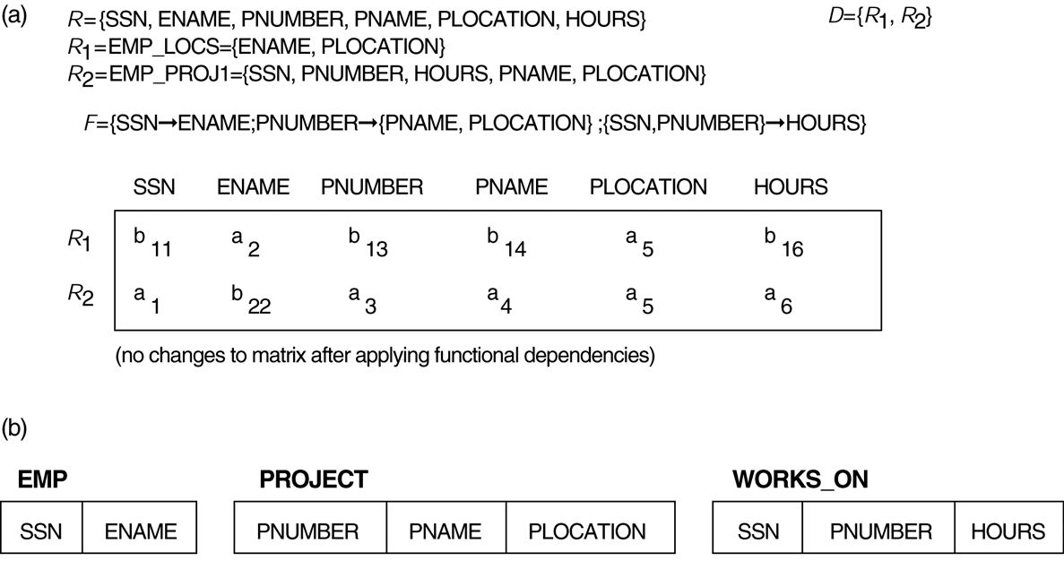
Properties of Relational Decompositions (8)
Lossless (nonadditive) join test for n-ary decompositions. (a) Case 1: Decomposition of EMP_PROJ into EMP_PROJ1 and EMP_LOCS fails test.
(b) A decomposition of EMP_PROJ that has the lossless join property.
Slide 11- ‹#›
Notes:
‹#›

Slide 15
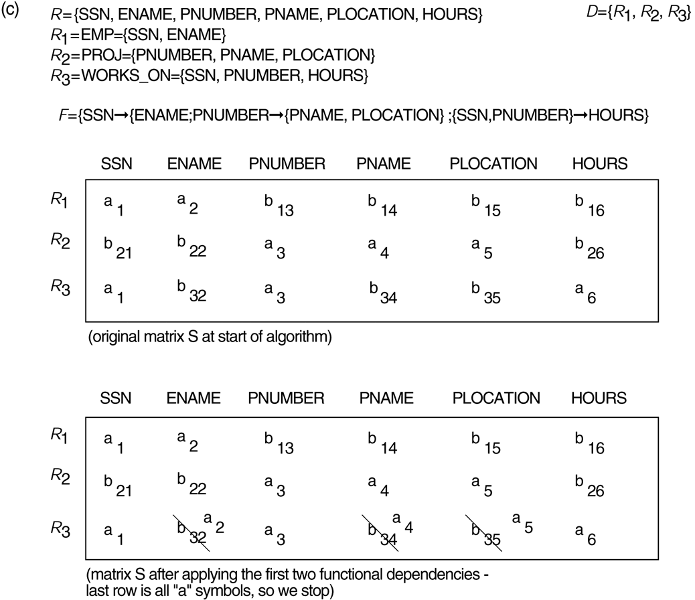
Properties of Relational Decompositions (8)
Lossless (nonadditive) join test for n-ary decompositions. (c) Case 2: Decomposition of EMP_PROJ into EMP, PROJECT, and WORKS_ON satisfies test.
Slide 11- ‹#›
Notes:
‹#›

Slide 16
Properties of Relational Decompositions (9)
Testing Binary Decompositions for Lossless Join Property
Binary Decomposition: Decomposition of a relation R into two relations.
PROPERTY LJ1 (lossless join test for binary decompositions): A decomposition D = {R1, R2} of R has the lossless join property with respect to a set of functional dependencies F on R if and only if either
The f.d. ((R1 ∩ R2) → (R1- R2)) is in F⁺, or
The f.d. ((R1 ∩ R2) → (R2 - R1)) is in F⁺.
Slide 11- ‹#›
Notes:
‹#›

Slide 17
Properties of Relational Decompositions (10)
Successive Lossless Join Decomposition:
Claim 2 (Preservation of non-additivity in successive decompositions):
If a decomposition D = {R1, R2, ..., Rm} of R has the lossless (non-additive) join property with respect to a set of functional dependencies F on R,
and if a decomposition Di = {Q1, Q2, ..., Qk} of Ri has the lossless (non-additive) join property with respect to the projection of F on Ri,
then the decomposition D2 = {R1, R2, ..., Ri-1, Q1, Q2, ..., Qk, Ri+1, ..., Rm} of R has the non-additive join property with respect to F.
Slide 11- ‹#›
Notes:
‹#›

Slide 18
2. Algorithms for Relational Database Schema Design (1)
Algorithm 11.2: Relational Synthesis into 3NF with Dependency Preservation (Relational Synthesis Algorithm)
Input: A universal relation R and a set of functional dependencies F on the attributes of R.
1. Find a minimal cover G for F (use Algorithm 10.2);
2. For each left-hand-side X of a functional dependency that appears in G,
create a relation schema in D with attributes {X υ {A1} υ {A2} ... υ {Ak}},
where X → A1, X → A2, ..., X → Ak are the only dependencies in G with X as left-hand-side (X is the key of this relation) ;
3. Place any remaining attributes (that have not been placed in any relation) in a single relation schema to ensure the attribute preservation property.
Claim 3: Every relation schema created by Algorithm 11.2 is in 3NF.
Slide 11- ‹#›
Notes:
‹#›

Slide 19
Algorithms for Relational Database Schema Design (2)
Algorithm 11.3: Relational Decomposition into BCNF with Lossless (non-additive) join property
Input: A universal relation R and a set of functional dependencies F on the attributes of R.
1. Set D := {R};
2. While there is a relation schema Q in D that is not in BCNF
do {
choose a relation schema Q in D that is not in BCNF;
find a functional dependency X → Y in Q that violates BCNF;
replace Q in D by two relation schemas (Q - Y) and (X υ Y);
};
Assumption: No null values are allowed for the join attributes.
Slide 11- ‹#›
Notes:
‹#›

Slide 20
Algorithms for Relational Database Schema Design (3)
Algorithm 11.4 Relational Synthesis into 3NF with Dependency Preservation and Lossless (Non-Additive) Join Property
Input: A universal relation R and a set of functional dependencies F on the attributes of R.
1. Find a minimal cover G for F (Use Algorithm 10.2).
2. For each left-hand-side X of a functional dependency that appears in G,
create a relation schema in D with attributes {X υ {A1} υ {A2} ... υ {Ak}},
where X → A1, X → A2, ..., X –>Ak are the only dependencies in G with X as left-hand-side (X is the key of this relation).
3. If none of the relation schemas in D contains a key of R, then create one more relation schema in D that contains attributes that form a key of R. (Use Algorithm 11.4a to find the key of R)
Slide 11- ‹#›
Notes:
‹#›

Slide 21
Algorithms for Relational Database Schema Design (4)
Algorithm 11.4a Finding a Key K for R Given a set F of Functional Dependencies
Input: A universal relation R and a set of functional dependencies F on the attributes of R.
1. Set K := R;
2. For each attribute A in K {
Compute (K - A)+ with respect to F;
If (K - A)+ contains all the attributes in R,
then set K := K - {A};
}
Slide 11- ‹#›
Notes:
‹#›

Slide 22
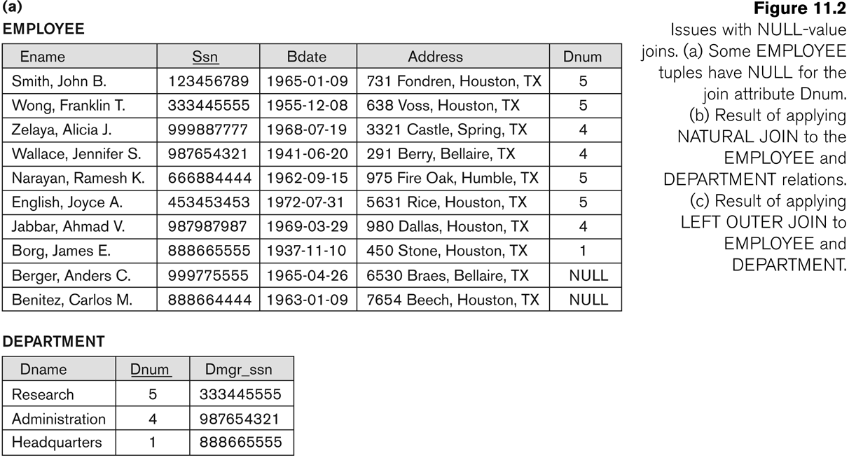
Algorithms for Relational Database Schema Design (5)
Slide 11- ‹#›
Notes:
‹#›

Slide 23
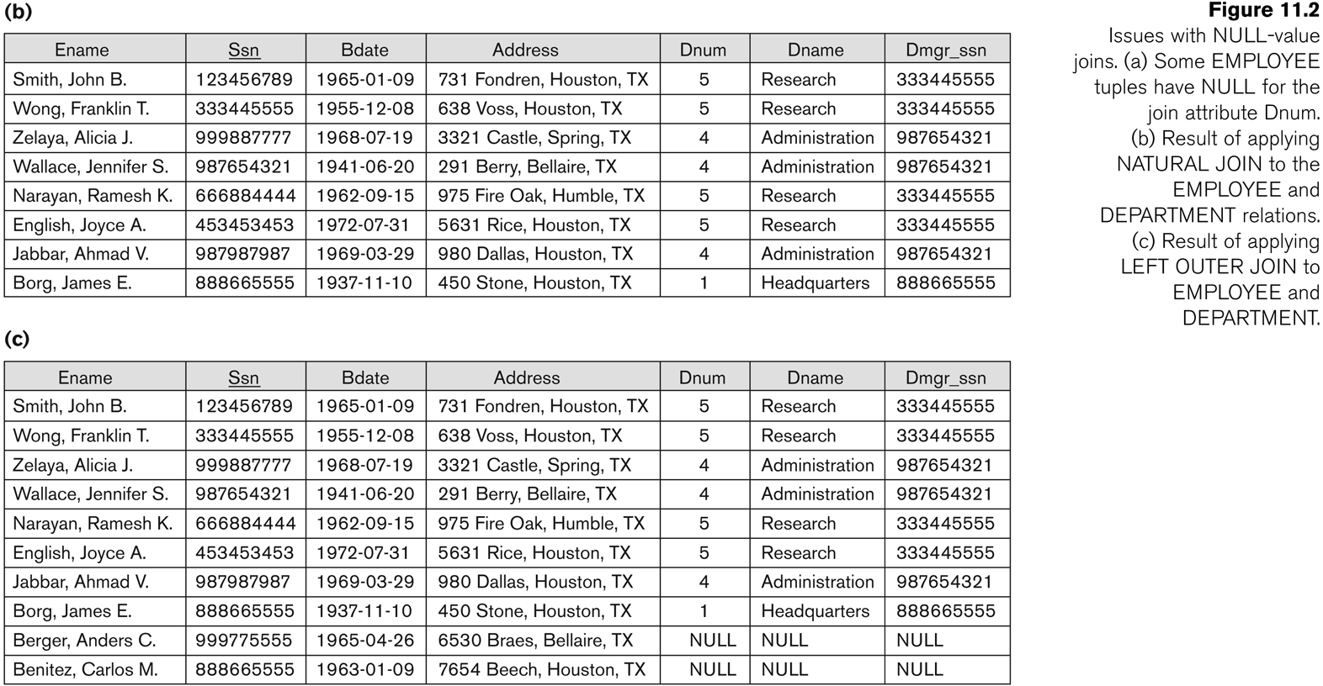
Algorithms for Relational Database Schema Design (5)
Slide 11- ‹#›
Notes:
‹#›

Slide 24
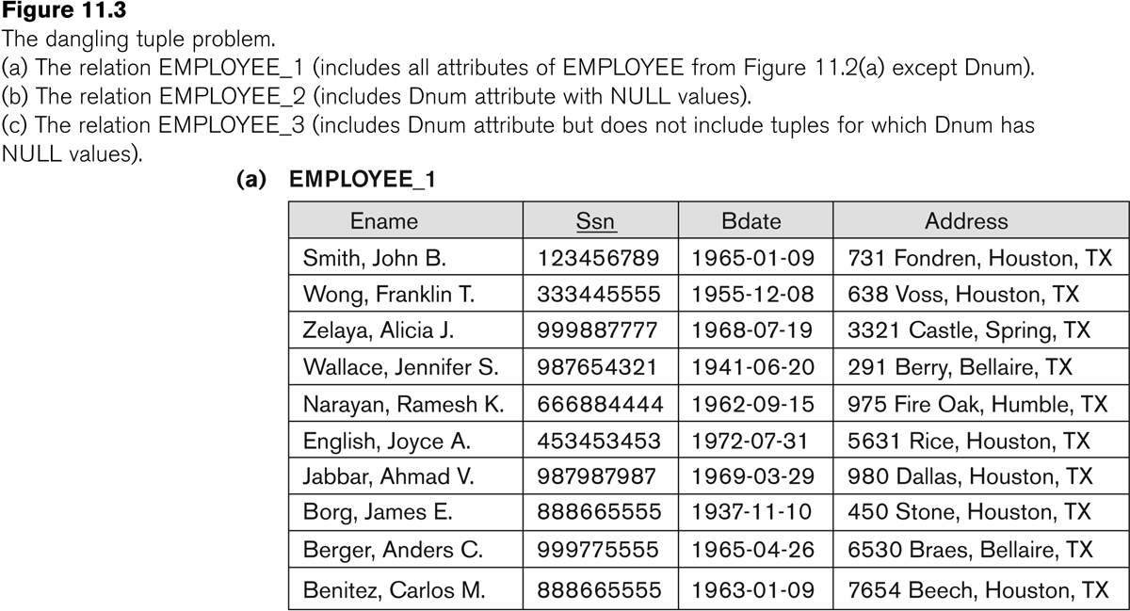
Algorithms for Relational Database Schema Design (6)
Slide 11- ‹#›
Notes:
‹#›

Slide 25
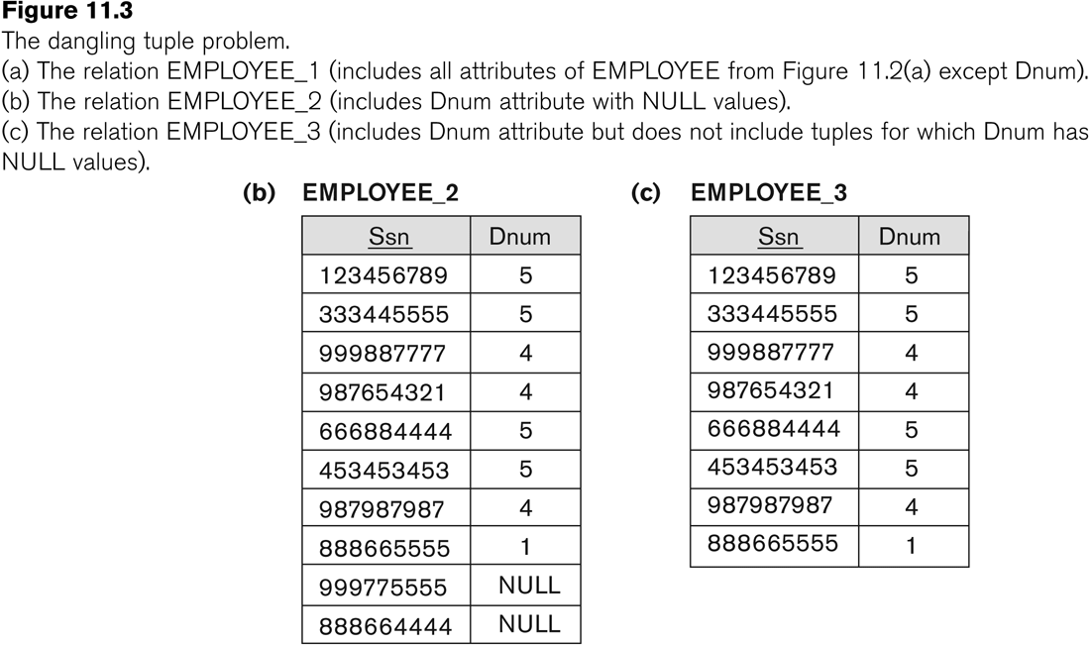
Algorithms for Relational Database Schema Design (6)
Slide 11- ‹#›
Notes:
‹#›

Slide 26
Algorithms for Relational Database Schema Design (7)
Discussion of Normalization Algorithms:
Problems:
The database designer must first specify all the relevant functional dependencies among the database attributes.
These algorithms are not deterministic in general.
It is not always possible to find a decomposition into relation schemas that preserves dependencies and allows each relation schema in the decomposition to be in BCNF (instead of 3NF as in Algorithm 11.4).
Slide 11- ‹#›
Notes:
‹#›

Slide 27
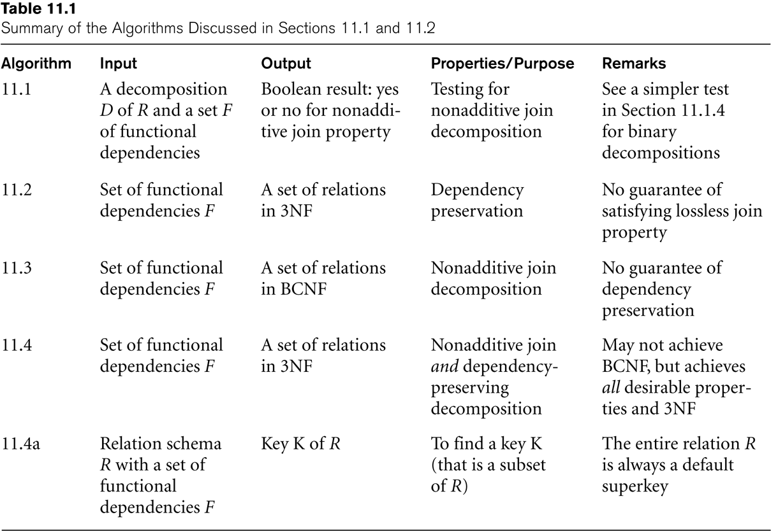
Algorithms for Relational Database Schema Design (8)
Slide 11- ‹#›
Notes:
‹#›

Slide 28
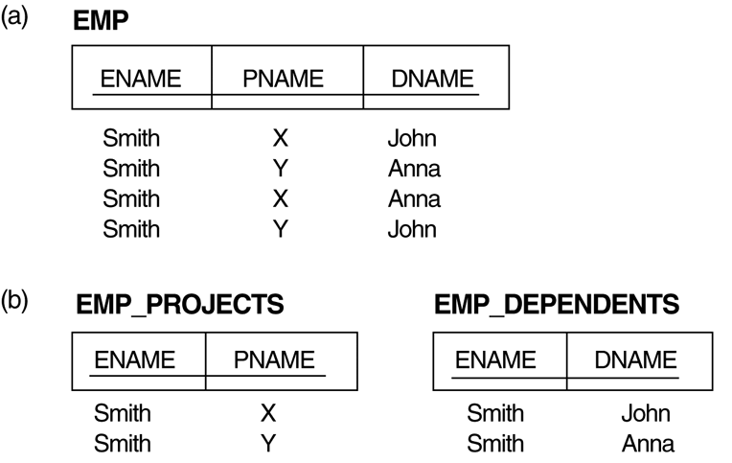
3. Multivalued Dependencies and Fourth Normal Form (1)
The EMP relation with two MVDs: ENAME —>> PNAME and ENAME —>> DNAME.
Decomposing the EMP relation into two 4NF relations EMP_PROJECTS and EMP_DEPENDENTS.
Slide 11- ‹#›
Notes:
‹#›

Slide 29
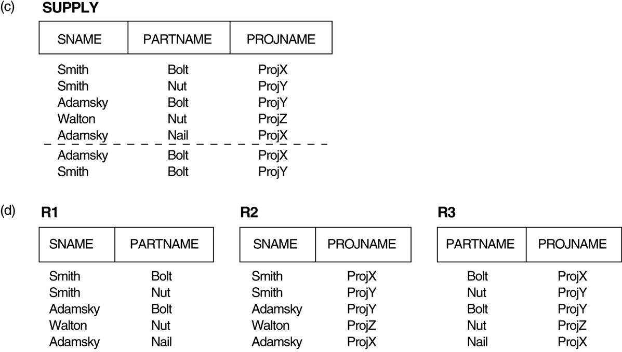
3. Multivalued Dependencies and Fourth Normal Form (1)
(c) The relation SUPPLY with no MVDs is in 4NF but not in 5NF if it has the JD(R1, R2, R3). (d) Decomposing the relation SUPPLY into the 5NF relations R1, R2, and R3.
Slide 11- ‹#›
Notes:
‹#›

Slide 30
Multivalued Dependencies and Fourth Normal Form (2)
Definition:
A multivalued dependency (MVD) X —>> Y specified on relation schema R, where X and Y are both subsets of R, specifies the following constraint on any relation state r of R: If two tuples t₁ and t₂ exist in r such that t₁[X] = t₂[X], then two tuples t₃ and t₄ should also exist in r with the following properties, where we use Z to denote (R - (X υ Y)):
t₃[X] = t₄[X] = t₁[X] = t₂[X].
t₃[Y] = t₁[Y] and t₄[Y] = t₂[Y].
t₃[Z] = t₂[Z] and t₄[Z] = t₁[Z].
An MVD X —>> Y in R is called a trivial MVD if (a) Y is a subset of X, or (b) X υ Y = R.
Slide 11- ‹#›
Notes:
‹#›

Slide 31
Multivalued Dependencies and Fourth Normal Form (3)
Inference Rules for Functional and Multivalued Dependencies:
IR1 (reflexive rule for FDs): If X ⊇ Y, then X –> Y.
IR2 (augmentation rule for FDs): {X –> Y} ⏐= XZ –> YZ.
IR3 (transitive rule for FDs): {X –> Y, Y –>Z} ⏐= X –> Z.
IR4 (complementation rule for MVDs): {X —>> Y} ⏐= X —>> (R – (X ∪ Y))}.
IR5 (augmentation rule for MVDs): If X —>> Y and W ⊇ Z then WX —>> YZ.
IR6 (transitive rule for MVDs): {X —>> Y, Y —>> Z} ⏐= X —>> (Z 2 Y).
IR7 (replication rule for FD to MVD): {X –> Y} ⏐= X —>> Y.
IR8 (coalescence rule for FDs and MVDs): If X —>> Y and there exists W with the properties that
(a) W ∩ Y is empty, (b) W –> Z, and (c) Y ⊇ Z, then X –> Z.
Slide 11- ‹#›
Notes:
‹#›

Slide 32
{X —>> Y, in R is trivial MVD if
a. Y is subset of X OR
b. XUY = R
An MVD which satisfies neither (a) nor (b) is called nontrivial MVD
Slide 11- ‹#›

Slide 33
Multivalued Dependencies and Fourth Normal Form (4)
Definition:
A relation schema R is in 4NF with respect to a set of dependencies F (that includes functional dependencies and multivalued dependencies) if, for every nontrivial multivalued dependency X —>> Y in F⁺, X is a superkey for R.
Note: F⁺ is the (complete) set of all dependencies (functional or multivalued) that will hold in every relation state r of R that satisfies F. It is also called the closure of F.
Slide 11- ‹#›
Notes:
‹#›

Slide 34
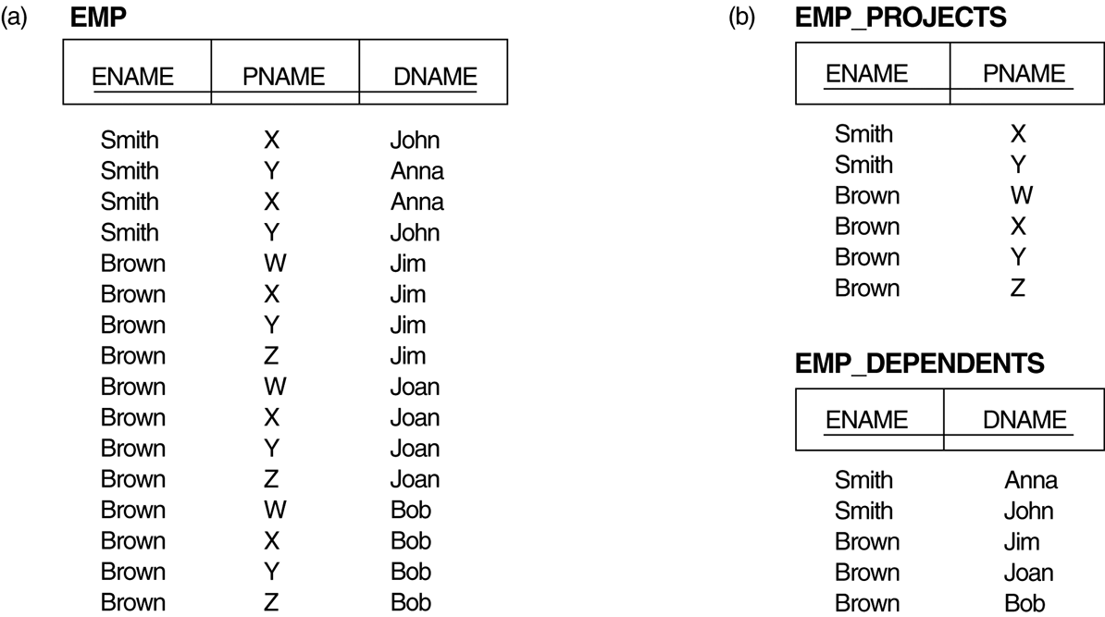
Multivalued Dependencies and Fourth Normal Form (5)
Decomposing a relation state of EMP that is not in 4NF:
EMP relation with additional tuples.
Two corresponding 4NF relations EMP_PROJECTS and EMP_DEPENDENTS.
Slide 11- ‹#›
Notes:
‹#›

Slide 35
Multivalued Dependencies and Fourth Normal Form (6)
Lossless (Non-additive) Join Decomposition into 4NF Relations:
PROPERTY LJ1’
The relation schemas R₁ and R₂ form a lossless (non-additive) join decomposition of R with respect to a set F of functional and multivalued dependencies if and only if
(R₁ ∩ R₂) —>> (R₁ - R₂)
or by symmetry, if and only if
(R₁ ∩ R₂) —>> (R₂ - R₁)).
Slide 11- ‹#›
Notes:
‹#›

Slide 36
Multivalued Dependencies and Fourth Normal Form (7)
Algorithm 11.5: Relational decomposition into 4NF relations with non-additive join property
Input: A universal relation R and a set of functional and multivalued dependencies F.
Set D := { R };
While there is a relation schema Q in D that is not in 4NF do {
choose a relation schema Q in D that is not in 4NF;
find a nontrivial MVD X —>> Y in Q that violates 4NF;
replace Q in D by two relation schemas (Q - Y) and (X υ Y);
};
Slide 11- ‹#›
Notes:
‹#›

Slide 37
4. Join Dependencies and Fifth Normal Form (1)
Definition:
A join dependency (JD), denoted by JD(R₁, R₂, ..., R_{n}), specified on relation schema R, specifies a constraint on the states r of R.
The constraint states that every legal state r of R should have a non-additive join decomposition into R₁, R₂, ..., R_{n}; that is, for every such r we have
* (π_{R1}(r), π_{R2}(r), ..., π_{Rn}(r)) = r
Note: an MVD is a special case of a JD where n = 2.
A join dependency JD(R₁, R₂, ..., R_{n}), specified on relation schema R, is a trivial JD if one of the relation schemas R_{i} in JD(R₁, R₂, ..., R_{n}) is equal to R.
Slide 11- ‹#›
Notes:
‹#›

Slide 38
Join Dependencies and Fifth Normal Form (2)
Definition:
A relation schema R is in fifth normal form (5NF) (or Project-Join Normal Form (PJNF)) with respect to a set F of functional, multivalued, and join dependencies if,
for every nontrivial join dependency JD(R₁, R₂, ..., R_{n}) in F⁺ (that is, implied by F),
every R_{i} is a superkey of R.
Slide 11- ‹#›
Notes:
‹#›

Slide 39
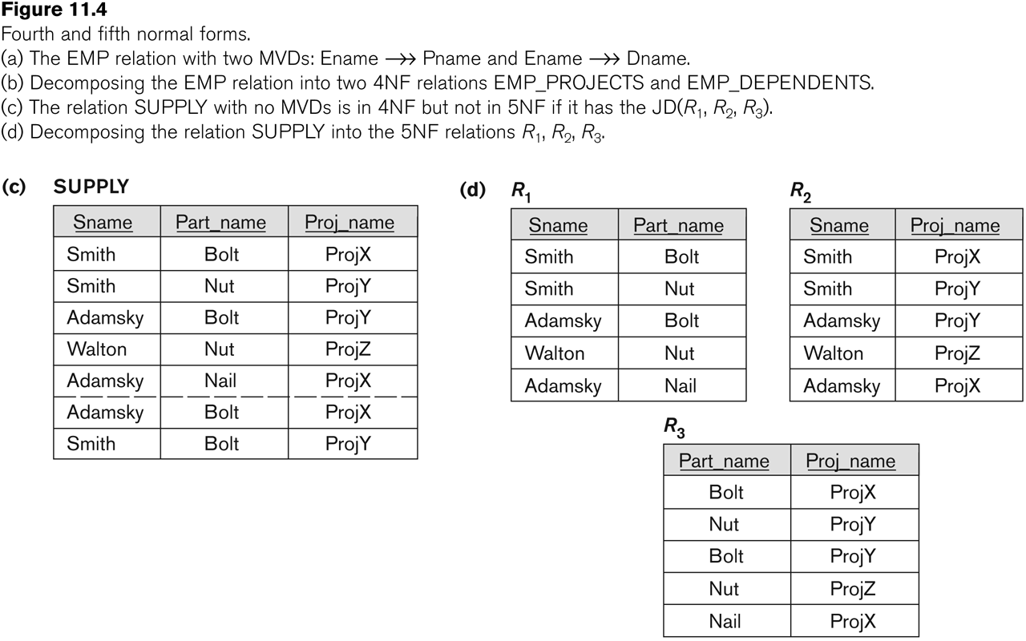
Relation SUPPLY with Join Dependency and conversion to Fifth Normal Form
Slide 11- ‹#›
Notes:
‹#›

Slide 40
5. Inclusion Dependencies (1)
Definition:
An inclusion dependency R.X < S.Y between two sets of attributes—X of relation schema R, and Y of relation schema S—specifies the constraint that, at any specific time when r is a relation state of R and s a relation state of S, we must have
π_{X}(r(R)) ⊇ π_{Y}(s(S))
Note:
The ? (subset) relationship does not necessarily have to be a proper subset.
The sets of attributes on which the inclusion dependency is specified—X of R and Y of S—must have the same number of attributes.
In addition, the domains for each pair of corresponding attributes should be compatible.
Slide 11- ‹#›
Notes:
‹#›

Slide 41
Inclusion Dependencies (2)
Objective of Inclusion Dependencies:
To formalize two types of interrelational constraints which cannot be expressed using F.D.s or MVDs:
Referential integrity constraints
Class/subclass relationships
Inclusion dependency inference rules
IDIR1 (reflexivity): R.X < R.X.
IDIR2 (attribute correspondence): If R.X < S.Y
where X = {A₁, A₂ ,..., A_{n}} and Y = {B₁, B₂, ..., B_{n}} and A_{i} Corresponds-to B_{i}, then R.A_{i} < S.B_{i}
for 1 ≤ i ≤ n.
IDIR3 (transitivity): If R.X < S.Y and S.Y < T.Z, then R.X < T.Z.
Slide 11- ‹#›
Notes:
‹#›

Slide 42
6. Other Dependencies and Normal Forms (1)
Template Dependencies:
Template dependencies provide a technique for representing constraints in relations that typically have no easy and formal definitions.
The idea is to specify a template—or example—that defines each constraint or dependency.
There are two types of templates:
tuple-generating templates
constraint-generating templates.
A template consists of a number of hypothesis tuples that are meant to show an example of the tuples that may appear in one or more relations. The other part of the template is the template conclusion.
Slide 11- ‹#›
Notes:
‹#›

Slide 43
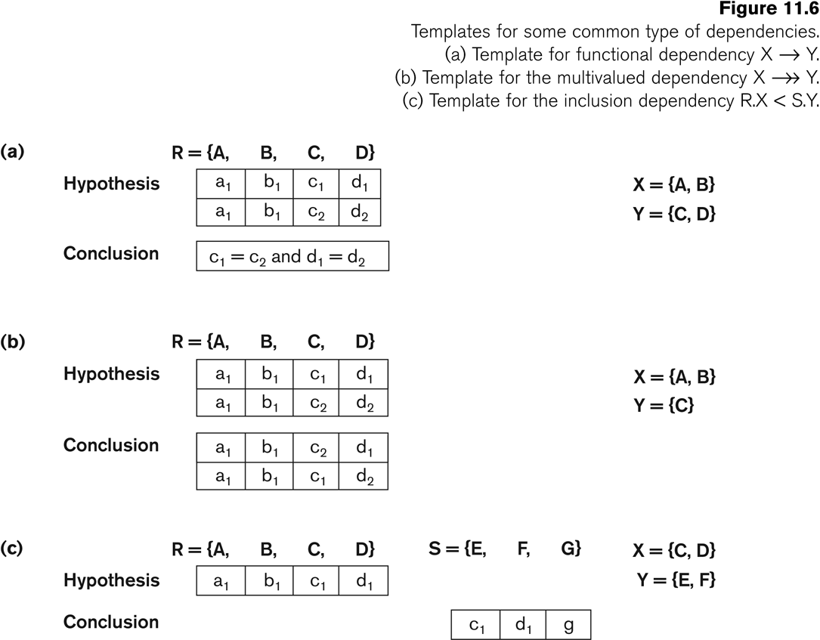
Other Dependencies and Normal Forms (2)
Slide 11- ‹#›
Notes:
‹#›

Slide 44
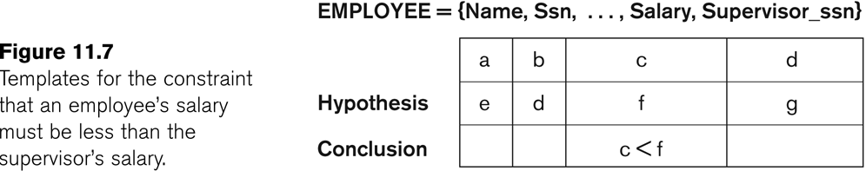
Other Dependencies and Normal Forms (3)
Slide 11- ‹#›
Notes:
‹#›

Slide 45
Other Dependencies and Normal Forms (4)
Domain-Key Normal Form (DKNF):
Definition:
A relation schema is said to be in DKNF if all constraints and dependencies that should hold on the valid relation states can be enforced simply by enforcing the domain constraints and key constraints on the relation.
The idea is to specify (theoretically, at least) the “ultimate normal form” that takes into account all possible types of dependencies and constraints. .
For a relation in DKNF, it becomes very straightforward to enforce all database constraints by simply checking that each attribute value in a tuple is of the appropriate domain and that every key constraint is enforced.
The practical utility of DKNF is limited
Slide 11- ‹#›
Notes:
‹#›

Slide 46
Recap
Designing a Set of Relations
Properties of Relational Decompositions
Algorithms for Relational Database Schema
Multivalued Dependencies and Fourth Normal Form
Join Dependencies and Fifth Normal Form
Inclusion Dependencies
Other Dependencies and Normal Forms
Slide 11- ‹#›
Notes:
‹#›

